Slide 1
Object Oriented Concepts
• Class & Object
• Access Specifier

Slide 2
OOPS
Object means a real-world entity such as a pen, chair, table, computer, watch, etc.
Object-Oriented Programming is a methodology or
paradigm to design a program using classes and objects.
It simplifies software development and maintenance by providing some concepts:
Key concepts of object-oriented programming are:
Abstraction
Encapsulation
Inheritance
Polymorphism

Slide 3
Abstraction
Abstraction is the process of identifying the key aspects of an entity and ignoring the rest.
Only those aspects are selected that are important to the current problem scenario.
Hiding internal details and showing functionality is known as abstraction.
For example phone call, we don't know the internal processing.

Slide 4
Encapsulation
Encapsulation is a mechanism used to hide the data,
internal structure and implementation details of an object.
All interaction with the object is through public interface of operations.
The user knows only about the interface;
any changes to the implementation does not affect the user.

Slide 5
Class
A class is a user defined blueprint or prototype from which objects are created.
It represents the set of properties or methods that are common to all objects of one type.
Class includes data members, methods, constructors etc…
E.g. Student,Employee,Customer,Account etc..

Slide 6
Object
It is a basic unit of Object Oriented Programming and represents the real life entities.
An object consists of :
State : It is represented by attributes of an object. (properties of an object) / instance variables(non static)
Behavior : It is represented by methods of an object (actions upon data)
Identity : It gives a unique identity to an object and enables one object to interact with other objects. eg : Emp id , Student PRN

Slide 7
Object Creation
The new operator instantiates a class by allocating memory for a new object and returning a reference to that memory. The new operator also invokes the class constructor.
e.g. Employee emp=new Employee();

Slide 8
Objects are created from the new keyword in Java.
Every time you do something like
ClassName objectName = new ClassName();
JVM allocates the necessary memory in the Heap Area to create this object, once this memory is allocated it holds the reference to this memory through some variable which is objectName here.
All object instances and arrays are stored in a heap.

Slide 9
Method Overloading
Reusing the same name for method.
The method calls are resolved at compile time using method signature.
Compile time error occurs if compiler cannot match the arguments or if more than one match is possible.
Method signature consists of
Number of arguments passed to a function.
Data types of arguments.
Sequence in which they are passed.

Slide 10
varArgs
varArgs means variable arguments.
Restricting number and type of input parameters while declaring the method.
Solution:make the signature dynamic.
To represent variable argument use operator called as ellipses (…) 3 dots after data type.
public void addTest(String message, int... numbers)
{
for(int i=0;i<numbers.length;i++)
{
System.out.println(numbers[i]);
}
}

Slide 11
varArgs
Method that accepts zero to many arguments is called as var-args method.
Used to reduce versions of overloaded methods in the application.
public void test(int…x,int…y) Invalid, more than one variable argument type.
public void test(int…x,String a) Invalid,variable argument type must be the last parameter.

Slide 13
Constructor
Constructor
is a special method having
same name as the class name
no explicit return type not even void
may be parameterized or parameter less.
Parameterized constructor is used init state of the object.
If a class does not explicitly declare any constr , the Java compiler automatically provides a no-argument constructor, called the default constructor.
This default constructor implicitly calls the super class's no-argument constructor

Slide 14
Constructor
A constructor is used to initialize a newly created object.
It is implicitly invoked just after the memory is allocated for the object using ‘new’ keyword.
It is a special method with same name as it’s class name.
No return type for constructor. Not even void.
A constructor without input parameter is default constructor.
Constructor can be overloaded.

Slide 15
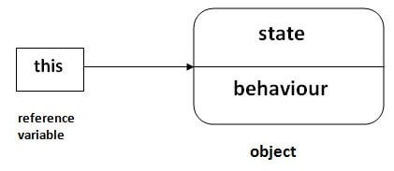
this keyword in Java
There can be a lot of usage of Java this keyword.
In Java, this is a reference variable that refers to the current object.

Slide 16
this keyword
1. To unhide , instance variables from method local variables.(to resolve the conflict)
eg : this.name=name;
2. To invoke the constructor , from another overloaded constructor in the same class.(constructor chaining , to avoid duplication)

Slide 17
this reference
Every class member gets a hidden parameter: the ‘this’ reference.
‘this’ is a keyword in Java.
‘this’ points to the current object.
‘this’ always holds address of an object which invokes the member function.
Why ‘this’?
access current object.
call the constructor of the same class.//constructor chaining
remove shadowing of instance fields.

Slide 18
this reference
public MyDate()
{
this(20);
}
public MyDate(int dd)
{
this.dd=dd;
}
//In main
MyDate m=new MyDate();
call the constructor of the same class
public MyDate(int dd,int mm,int yy)
{
this.dd=dd;
this.mm=mm;
this.yy=yy;
}
remove shadowing of instance fields

Slide 19
public MyDate(int dd,int mm,int yy)
{
this.dd=dd;
this.mm=mm;
this.yy=yy;
}

Slide 20
Variables in Java
Class Variables
Copy created per class
static variables
Instance Variables
Copy created per instance of the class.
Local Variable
Occur within a method and blocks
Copy created per method call
If used ,must be initialized or compiler complains

Slide 21
Accessor and Mutator Methods
Accessor /getters methods merely access instance fields/variables.
e.g. getXXX() methods
Mutator /setters methods actually change contents of instance fields.
e.g. setXXX(…) methods
class MyDate
{
private int day,month,year;
public void setDay (int d)
{
day=d;
}
public int getDay()
{
return day;
}
}

Slide 22
static Variable
Some characteristics or behaviors belong to the class rather than a specific instance
interestRate,calculateInterest method for a savingsAccount class.
count variable in Employee to count the number of objects.
Such data members are static for all instances.
Change in static variable value affects all instances.

Slide 23
The static keyword in Java is used for memory management mainly. We can apply static keyword with variables, methods, blocks and nested classes. The static keyword belongs to the class than an instance of the class.
The static can be:
Variable (also known as a class variable)
Method (also known as a class method)
Block
Nested class

Slide 24
If you declare any variable as static, it is known as a static variable.
The static variable can be used to refer to the common property of all objects (which is not unique for each object), for example, the company name of employees, college name of students, etc.
The static variable gets memory only once in the class area at the time of class loading.
Advantages of static variable
It makes your program memory efficient (i.e., it saves memory).

Slide 25
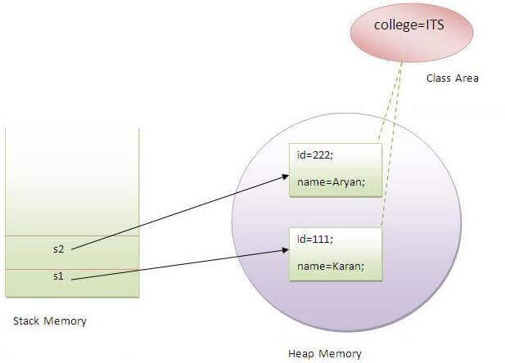

Slide 26
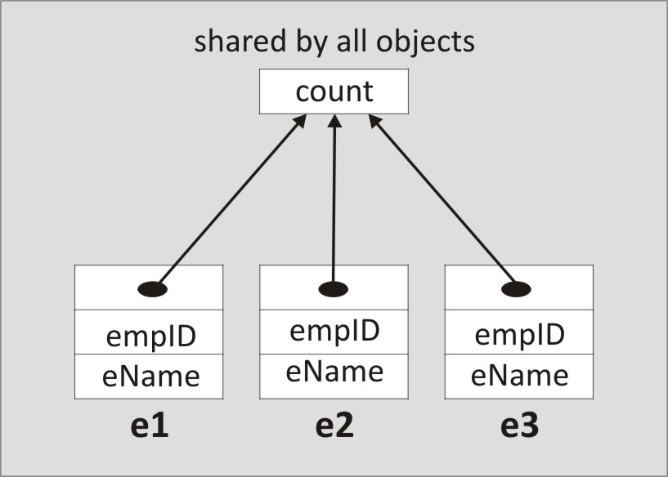
static Variables in Memory
Only single copy exists

Slide 27
static Method
static method can access static data members only.
static method is invoked using class name.
<class name>.<method name>()
Reference ‘this’ is never passed to a static method.

Slide 28
Java static method
If you apply static keyword with any method, it is known as static method.
A static method belongs to the class rather than the object of a class.
A static method can be invoked without the need for creating an instance of a class.
A static method can access static data member and can change the value of it.

Slide 29
static Method
public class Employee
{
private static int count;
public static int showCount()
{
return count;
}
}
public static void main(String args[])
{
int numberOfEmployees= Employee.showCount();
System.out.println(numberOfEmployees);
}

Slide 30
public static void main
main() is static method and called before instantiation of the class.
Since it is static, it is automatically invoked by the startup code.
It is the entry point of a class.
Loader will load the class and search for main method to enter into class, so main()is declared as static.
So, ClassName.main(…)

Slide 31
Q) Why is the Java main method static?
Ans) It is because the object is not required to call a static method. If it were a non-static method, JVM creates an object first then call main() method that will lead the problem of extra memory allocation.

Slide 32
static initialization blocks
Arbitrary blocks of code.
Executed before main() when class is loaded.
Used for initializing static variables.
A class can have more than one static blocks.
If more than one static blocks exists in a program then called in the order they appear in the source code.
static
{
//manipulation of static variables
}

